Slide 1

港島幼童軍229旅
2011年迎新營
手冊
日期: 2011年10月15至16日
集合時間: 下午二時三十分
宿營地點: 鯉魚門公園及度假村
(香港柴灣道75號)
集合地點: 鯉魚門公園及度假村辦事處(附件 1)
交通: 自行前往。請看附件2。

Slide 2
職員表
營主任 | 黃一華 | 63327762
輔助領袖 | 陳振炎 | 91357037
 | 許舜莉
 | 許世祺
 | 陳瑞娟
 | 張淑雯
程序表
 | 10月15
2:30pm | 集合及報到
2:30-3:30pm | 辦理入營手續,分配營舍,升旗
3:30-6:00pm | 營內康體活動(附件3)
6:00-6:30pm | 降旗,來年活動簡介
6:30-7:30pm | 晚膳
7:30-10:00pm | 幼童軍晚會
10:00-11:00pm | 梳洗/準備休息
11:00pm | 休息

Slide 3
 | 10月16
7:00-7:30am | 起牀/梳洗
7:30-7:35am | 升旗
7:35-8:15am | 早操 /團呼訓練
8:15-9:00am | 早餐
9:00-11:00am | 營內康體活動(附件2)
11:00-12:00noon | 收拾行李 ﹝11:30 交還營舍鎖匙﹞
12:00-1:00pm | 午膳
1:00pm | 離營
請各家長於10月16日下午1時於營地接回貴子女

Slide 4
營舍分配
營舍 | 1 | 2 | 3 | 4 | 5 | 6
領袖 | 陳瑞娟 |  | 許舜莉 |  | 雷永昌 | 張淑雯
隊長 | 李明心 | 陳奕廷 | 廖旨翹 | 文智達
隊副 |  | 黃知珩 |  | 郭志皓 | 楊俊
隊員 | 陳暉梠 許旖瑄 | 陳尊正 陳智煊 羅智賢 | 莊汶欣 莊汶希 | 吳浚彥 黃知文 文智鈞 | 蔣樂心 李俊輝 雷碩輝 | 李穎婷 許恩湲 袁晧晴
營舍 | 7
領袖 | 陳振炎 黃一華 許世祺
Room 1-6 can maximally accommodate 5 occupants per room whereas room 7 can only accommodate 4 persons at most.

Slide 5
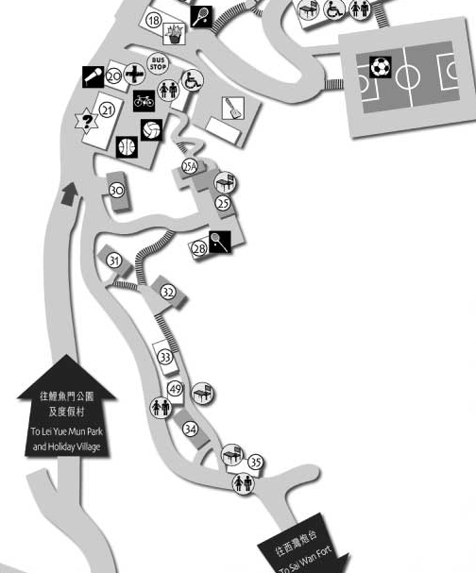
附件 1
Park Office
公園辦事處

Slide 6
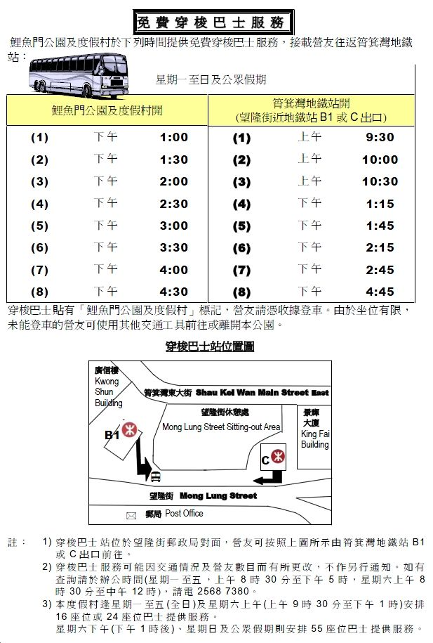
附件2

Slide 7
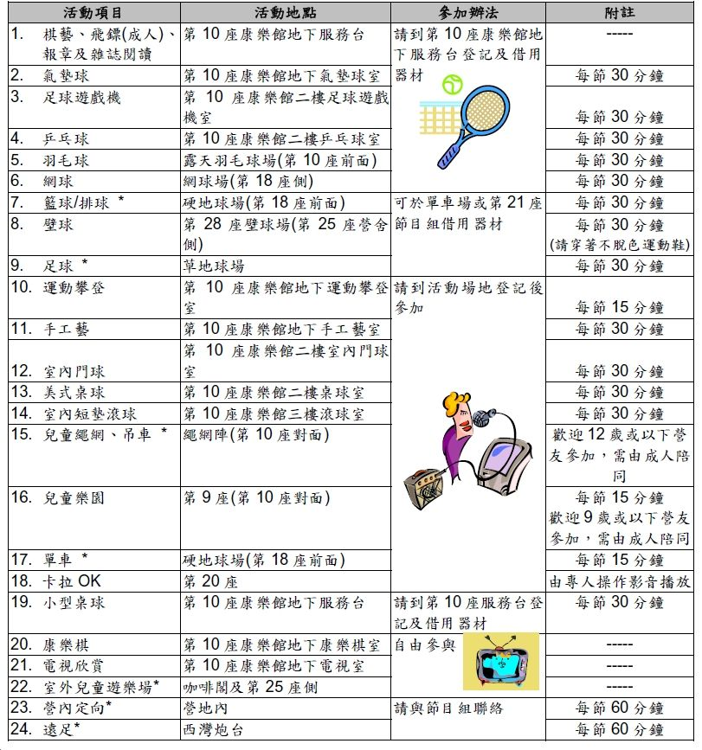
附件3

Slide 8
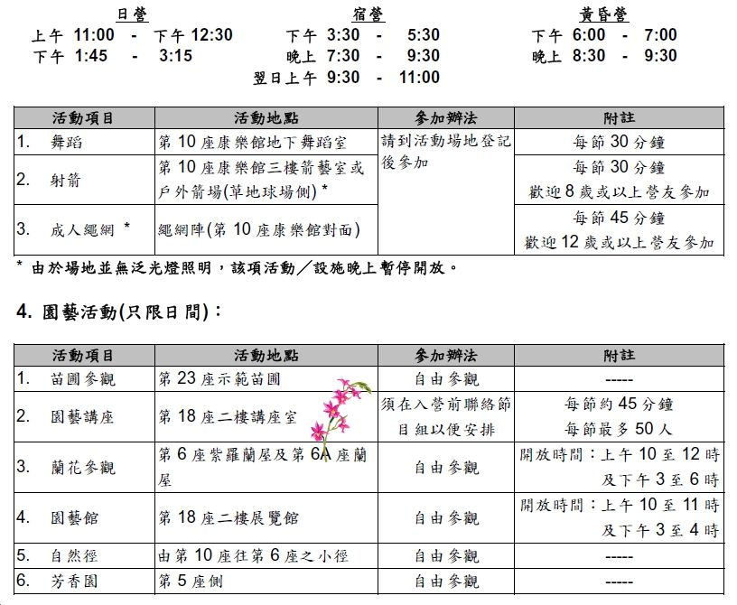
附件3
教練指導的康體活動
園藝活動

Slide 9
Songs everyone has to know
B-P spirit
I’ve got the B-P spirit
Right in my head Right in my head
Right in my head
I’ve got the B-P spirit Right in my head
Right in my head to stay
I’ve got the B-P spirit Deep in my heart
Deep in my heart Deep in my heart
I’ve got the B-P spirit Deep in my heart
Deep in my heart to stay
I’ve got the B-P spirit All around my feet
All around my feet All around my feet
I’ve got the B-P spirit All around my feet
All around my feet to stay I’ve got the B-P spirit Right in my head
Deep in my heart All around my feet
I’ve got the B-P spirit All over me
All over me to stay
童軍開飯歌
叮噹叮噹、叮噹叮噹、一群童軍、聚首一堂、感謝上主、賜我用粮。

Slide 10

My Bonnie
My Bonnie lies over the ocean
My Bonnie lies over the sea
My Bonnie lies over the ocean
Oh bring back my Bonnie to me
Bring back, bring back
Bring back my Bonnie to me, to me
Bring back, bring back
Bring back my Bonnie to me
Last night as I lay on my pillow
Last night as I lay on my bed
Last night as I lay on my pillow
I dreamed that my Bonnie was dead
Bring back, bring back
Bring back my Bonnie to me, to me
Bring back, bring back
Bring back my Bonnie to me
Oh blow ye the winds o’er the ocean
And blow ye the winds o’er the sea
Oh blow ye the winds o’er the ocean
And bring back my Bonnie to me
Bring back, bring back
Bring back my Bonnie to me, to me
Bring back, bring back
Bring back my Bonnie to me
The winds have blown over the ocean
The winds have blown over the sea
The winds have blown over the ocean
And brought back my Bonnie to me
Bring back, bring back
Bring back my Bonnie to me, to me
Bring back, bring back
Bring back my Bonnie to me
Pack up your troubles
Pack up your troubles in your old kit bag
And smile, smile, smile.
Don't let your joy and laughter hear the snag
Smile boys, that's the style
What's the use of worrying
It never was worth while
So, pack up your troubles in your old kit bag
And smile, smile, smile.
(Musical Interlude)
Pack up your troubles in your old kit bag
And smile, smile, smile.
Just pucker up and whistle (Whistle)
(Whistling)
What's the use of worrying
It never was worth while
So, pack up your troubles in your old kit bag
And smile, smile, smile.
(N.B. This is Spike Jones' version. In other versions I've heard,
the third line is:
"while you've a Lucifer to light your fag"

